Slide 1
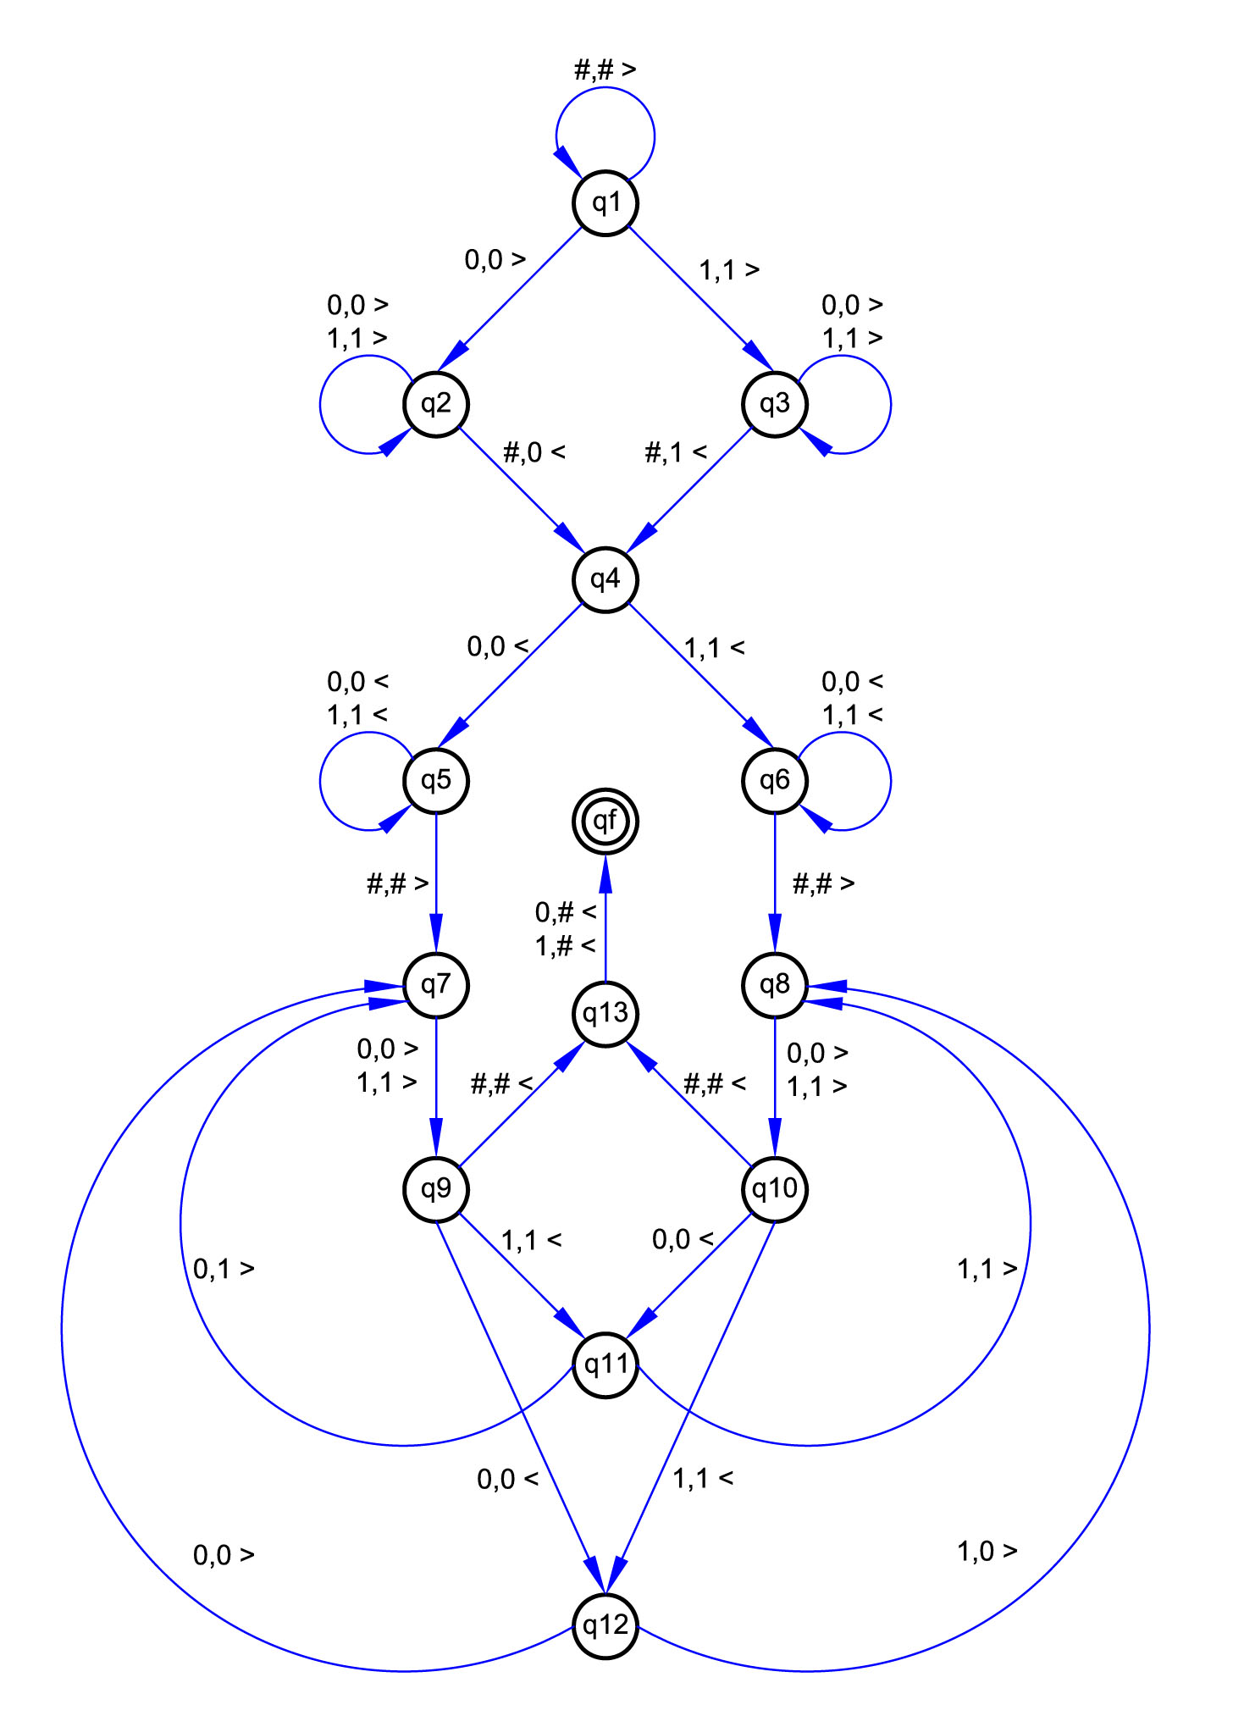

"If you want to teach people a new way of thinking, don't bother trying to teach them. Instead, give them a tool, the use of which will lead to new ways of thinking."
(R. Buckminster Fuller)
Lógica de programação aplicada à criação e análise da forma
Aula 03 - Funções e Loops
Fernando Ferraz Ribeiro
fernando.ribeiro@ufba.br

Slide 2
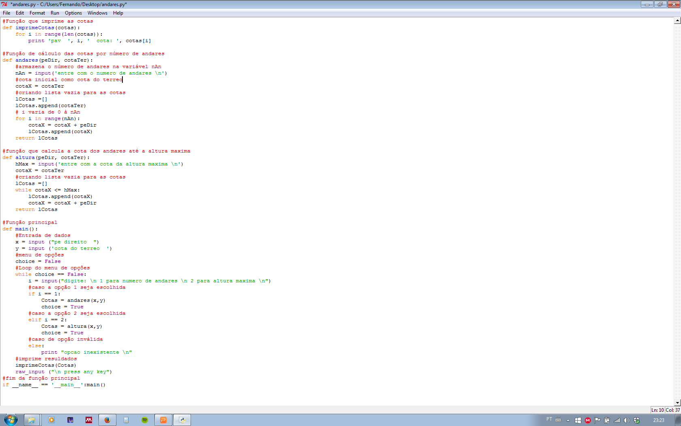
Loops (repetições)
Loop while
Loop for

Slide 3
Funções

